Slide 1
VISUAL REPRESENTATION OF MILE STONES
Presented by:
KALIGIRI NAGA MALLESWARI

Slide 2
MILE STONE-2
Visual Exploration and Delay Trends

Slide 3
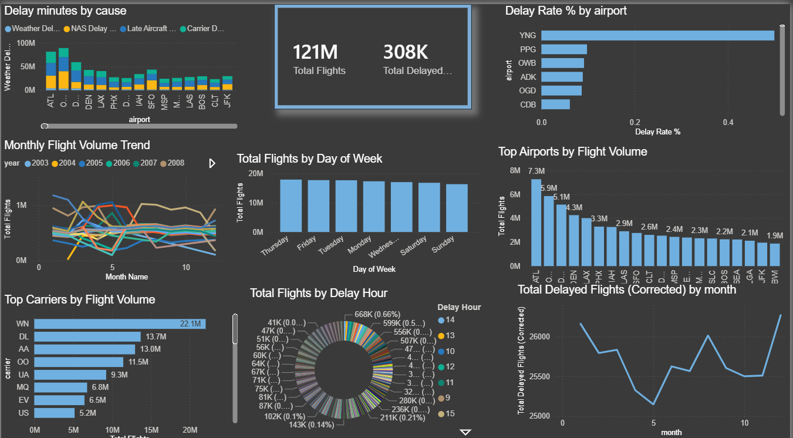

Slide 4
MILE STONE-3
Route, Cancellation, and Seasonal Insights

Slide 5
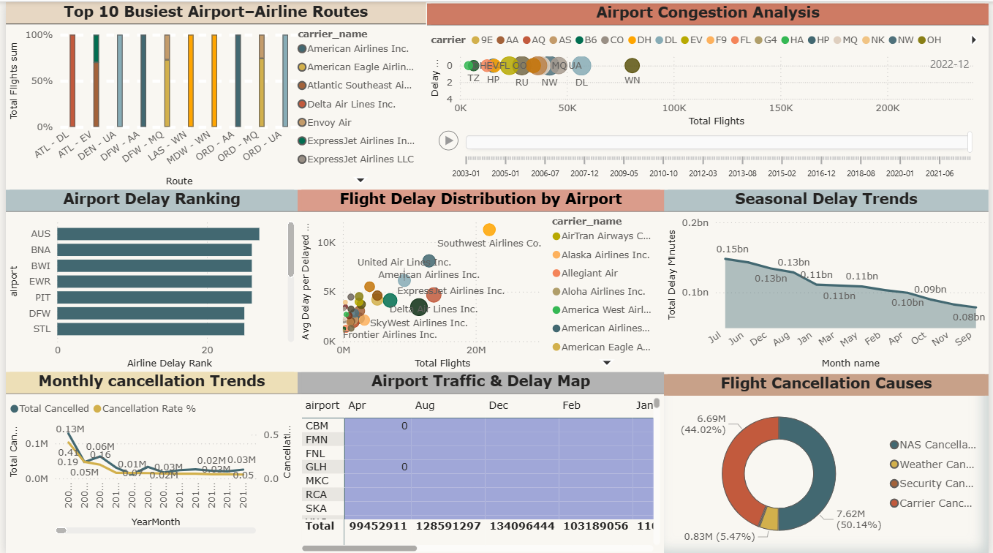

Slide 6
MILE STONE -4
Report and Presentation

Slide 7
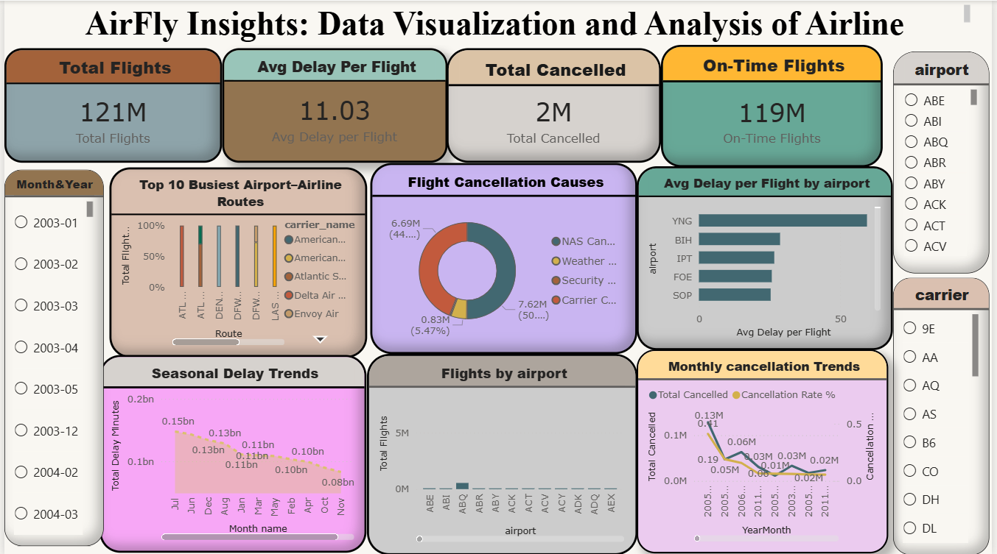

Slide 8
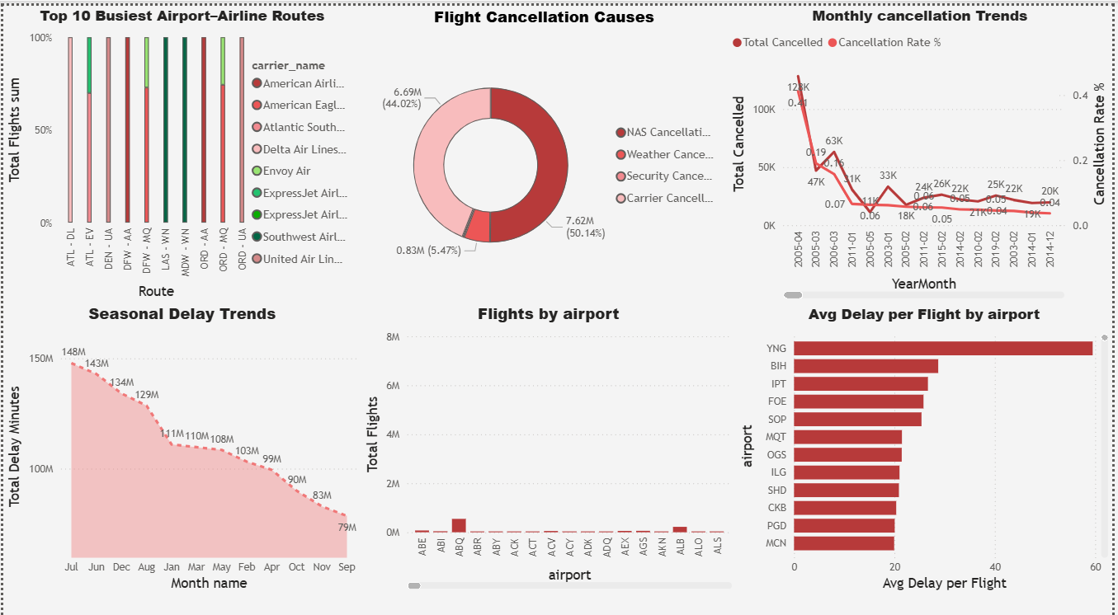

Slide 9
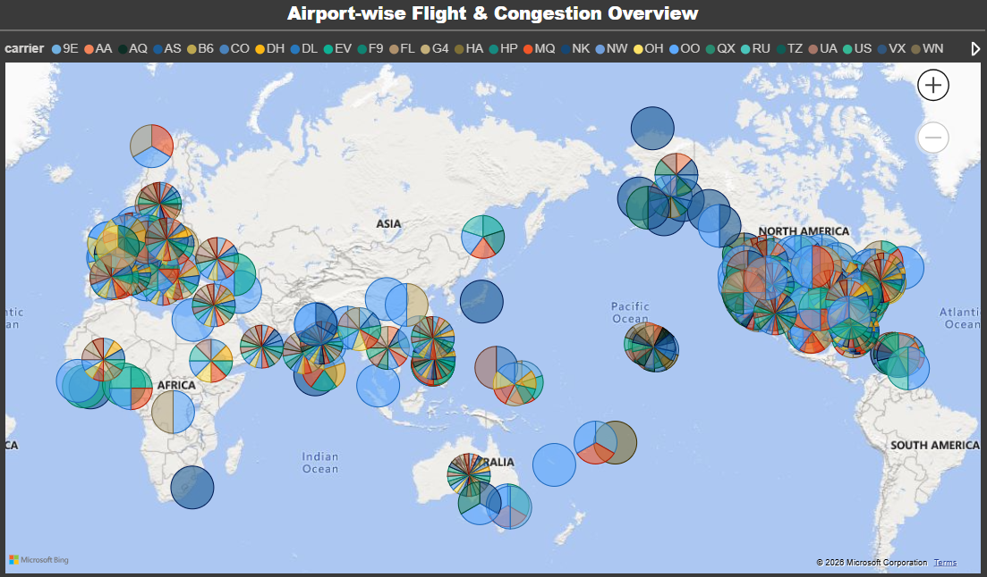

Slide 10
THANK YOU

